Slide 1
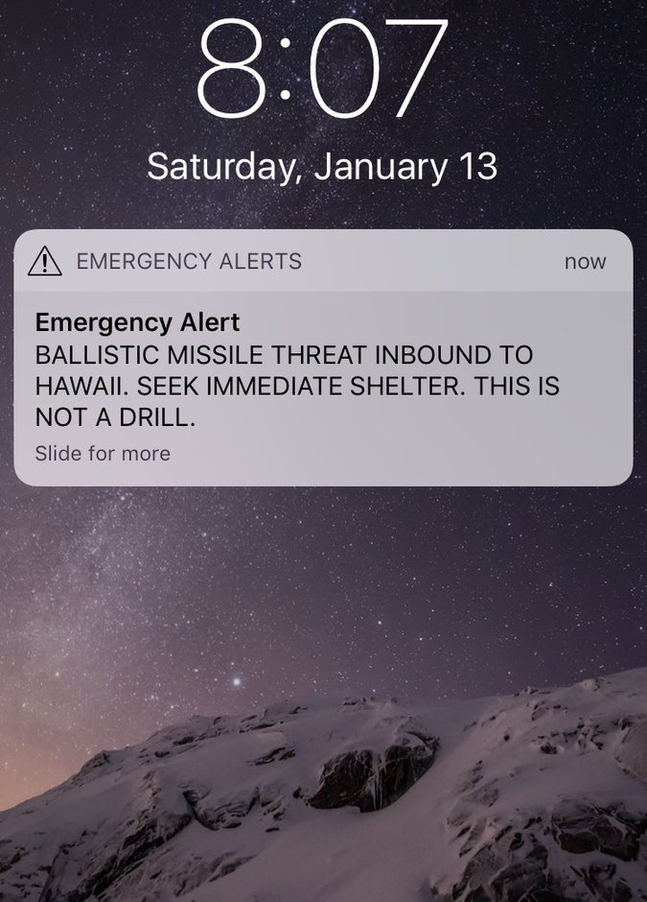

Emergency Alert
BALLISTIC MISSLE THREAT INBOUND TO HAWAII. SEEK IMMEDIATE SHELTER. THIS IS NOT A DRILL.

Slide 2
If this had been an actual emergency...
What would you do?
Where would you go?
Would you be ready?
Israel, Hosea 10:8
Jerusalem, Luke 23:28-31
Persecutors, Rev. 6:15-16
“For the great day of wrath has come, and who is able to stand?” (Revelation 6:17)

Slide 3
The Great Day of His Wrath 2 Peter 3:10-14
Will come without warning, v. 10
Cataclysmic, complete destruction, v. 10, 11, 12
Prompts holiness and godliness, v. 11, 14
3

Slide 4
The nature of judgment Matthew 24:36-44
God’s decision, v. 36
Unexpected, v. 37-39
Sudden, no escape, v. 40-41; Lk. 17:32-37
Get ready, v. 42-44
Stay ready, v. 45-51
4

Slide 5
Are you Ready for the Judgment Day? 1 Thessalonians 5:1-11
Yes, if a Christian, v. 1-5
Yes, if you’re a watchful Christian, v. 6-8
Remember why Jesus died, v. 9-10
The prepared are comforted, v. 11
5

Slide 6
Now is the Day of Salvation 2 Corinthians 6:2 2 Peter 3:11-14
To become a Christian
To be a watchful Christian
To remember Jesus died to save you
To look for eternal comfort
6

Slide 7
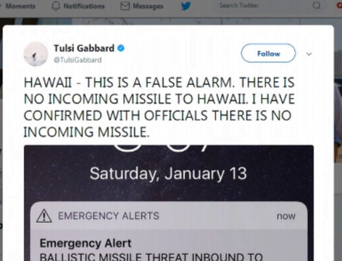
FALSE ALARM!
7

Slide 8
If this had been The end of the world…
No place to hide!
(Revelation 6:16-17)
8

Slide 9
This is Your Warning. This is not a drill.
Seek immediate shelter in Christ.
9

Slide 10

10

